Slide 1
4483/8995 CAPSTONE PROJECT PRESENTATION
Fifty States car License Plates dataset
JiahaoHu/IDs: u3232682
TUTORIAL GROUP – WEEK DAY/TIME: Wednesday 9:30am

Slide 2
Table of Contents
Introduction / Problem Statement
Dataset Details
EDA Outcomes
PDA Outcomes
Implementation and Deployment TkInter

Slide 3
Introduction / Problem Statement
Question 1: How to display images?
Question 2: How the pictures will be look like after rotating and flipping?
Question 3: How can you find the minimum or maximum values in an image matrix
Question 4: How to convert a color image into a grayscale image?
Question 5: How to show the Gradient Image and histogram images?

Slide 4
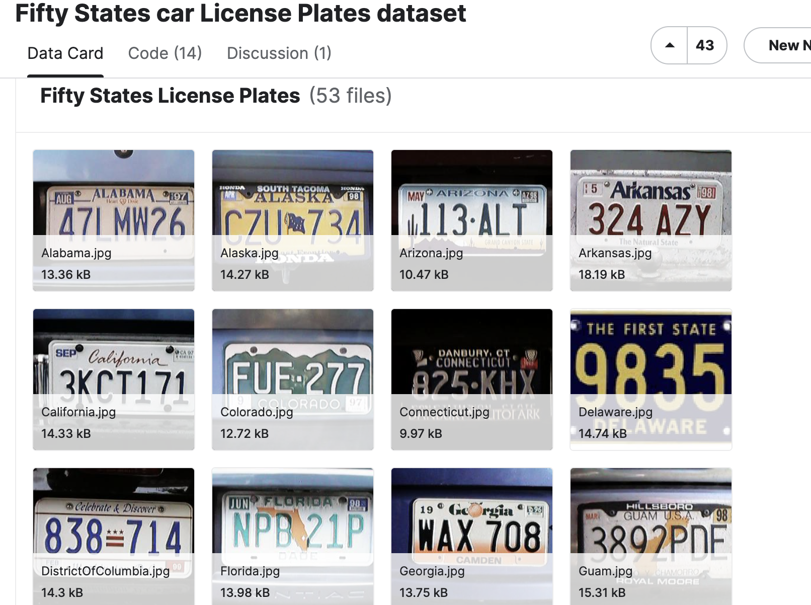
2. Dataset Details
1, Plates from different states 2, Totally 53 files 3, But one dataset

Slide 5
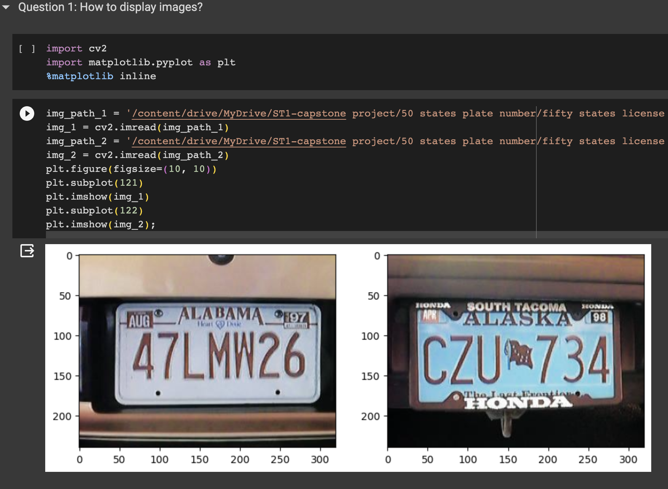
3. EDA (Exploratory Data Analysis) Outcomes
1, Display images

Slide 6
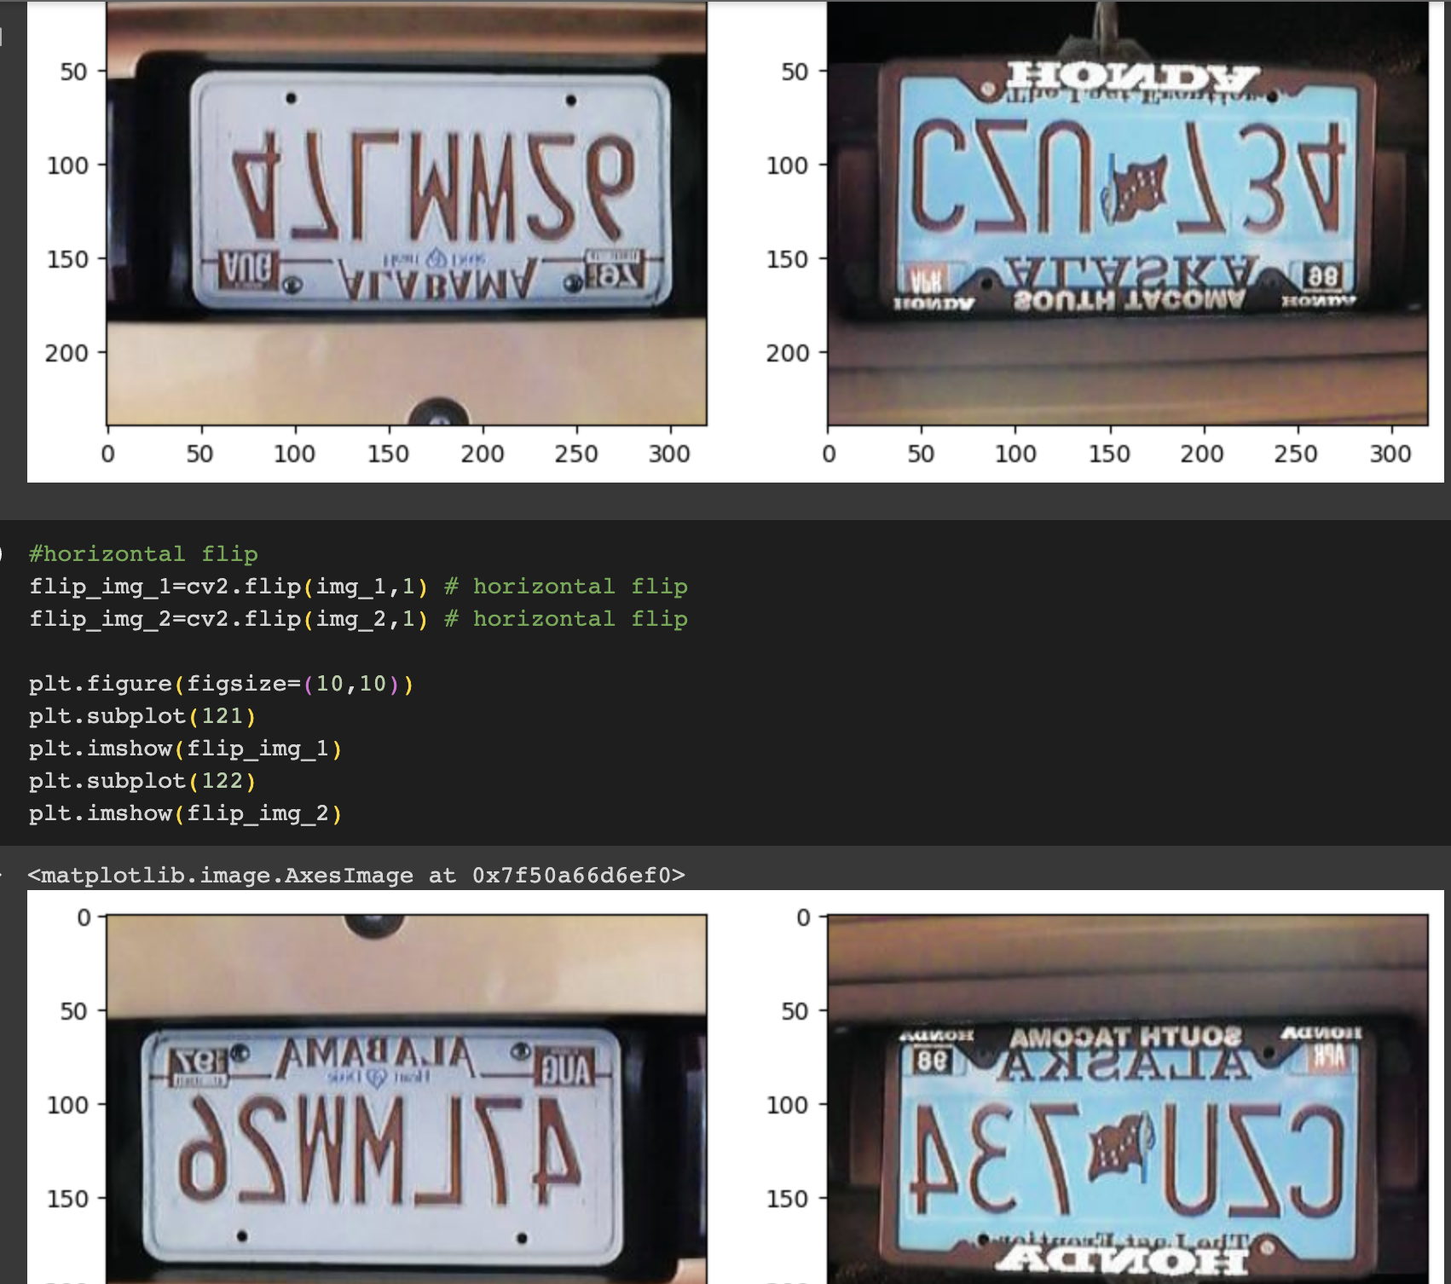
3. EDA (Exploratory Data Analysis) Outcomes
2, Flip images

Slide 7
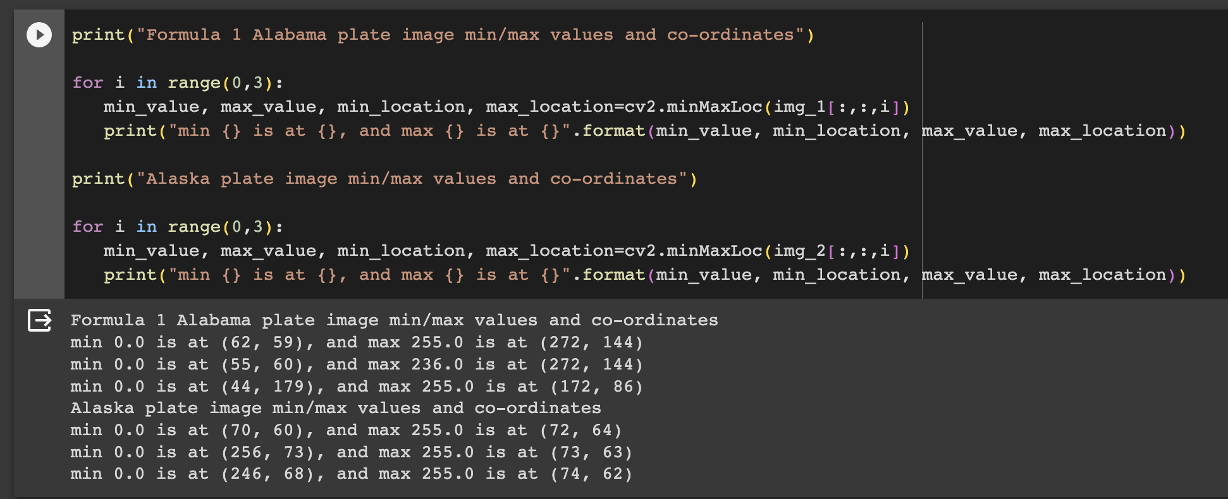
3. EDA (Exploratory Data Analysis) Outcomes
3, The minimum or maximum values in an image matrix

Slide 8
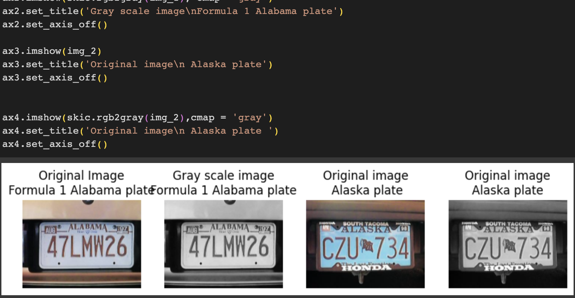
3. EDA (Exploratory Data Analysis) Outcomes
4, Grayscale image

Slide 9
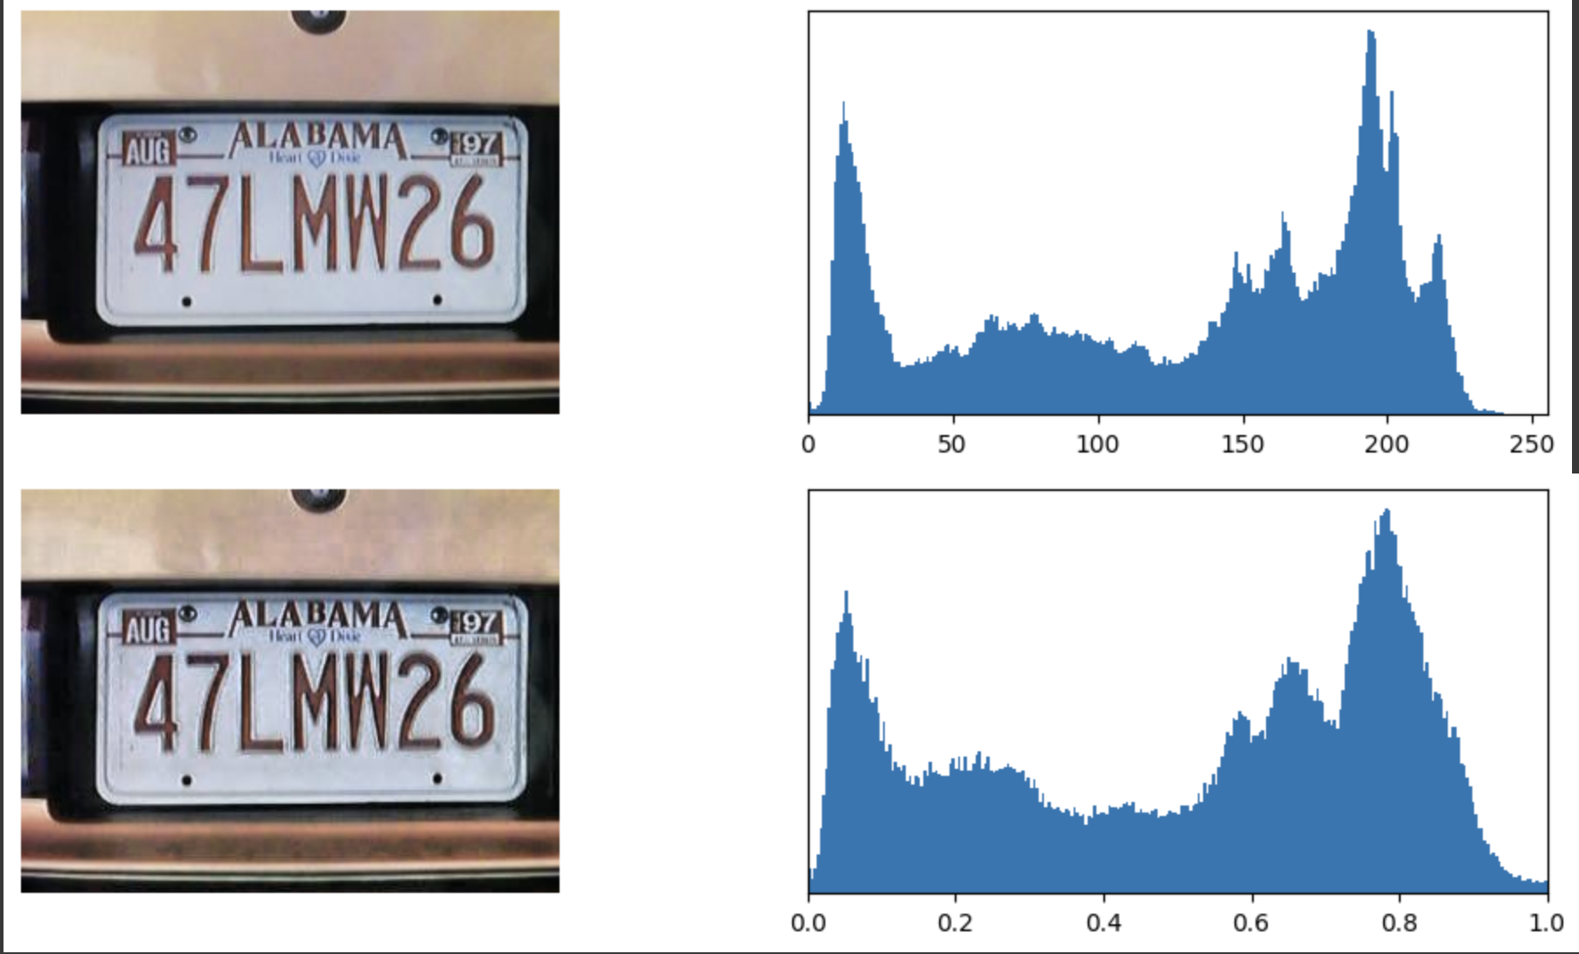
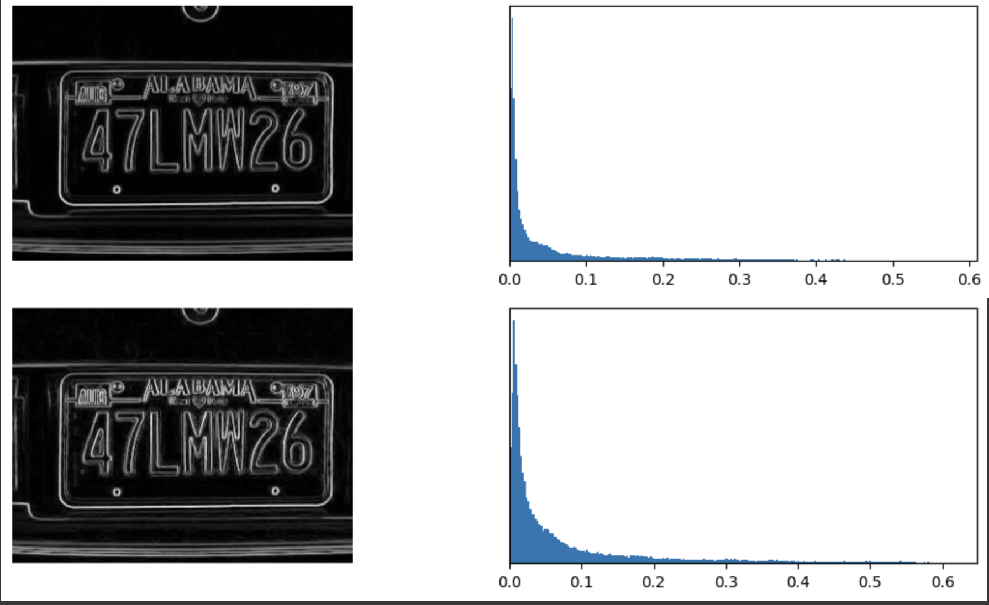
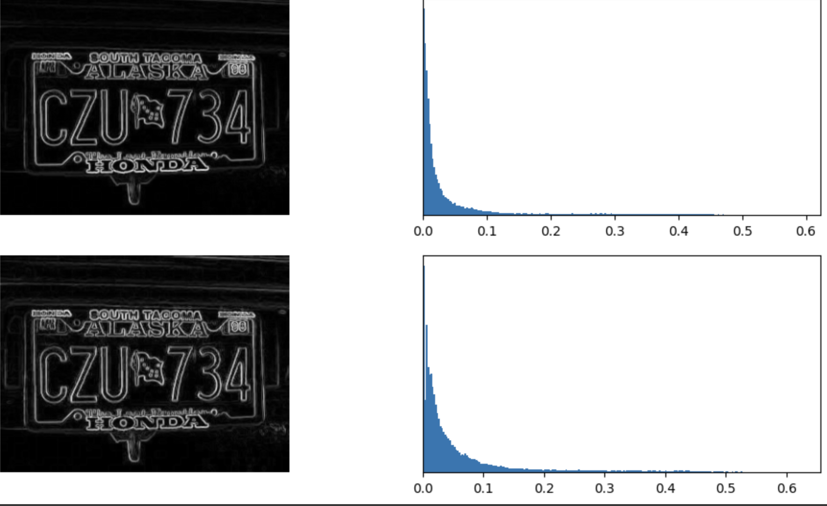
3. EDA (Exploratory Data Analysis) Outcomes
5, Gradient Image and histogram of the iamages

Slide 10
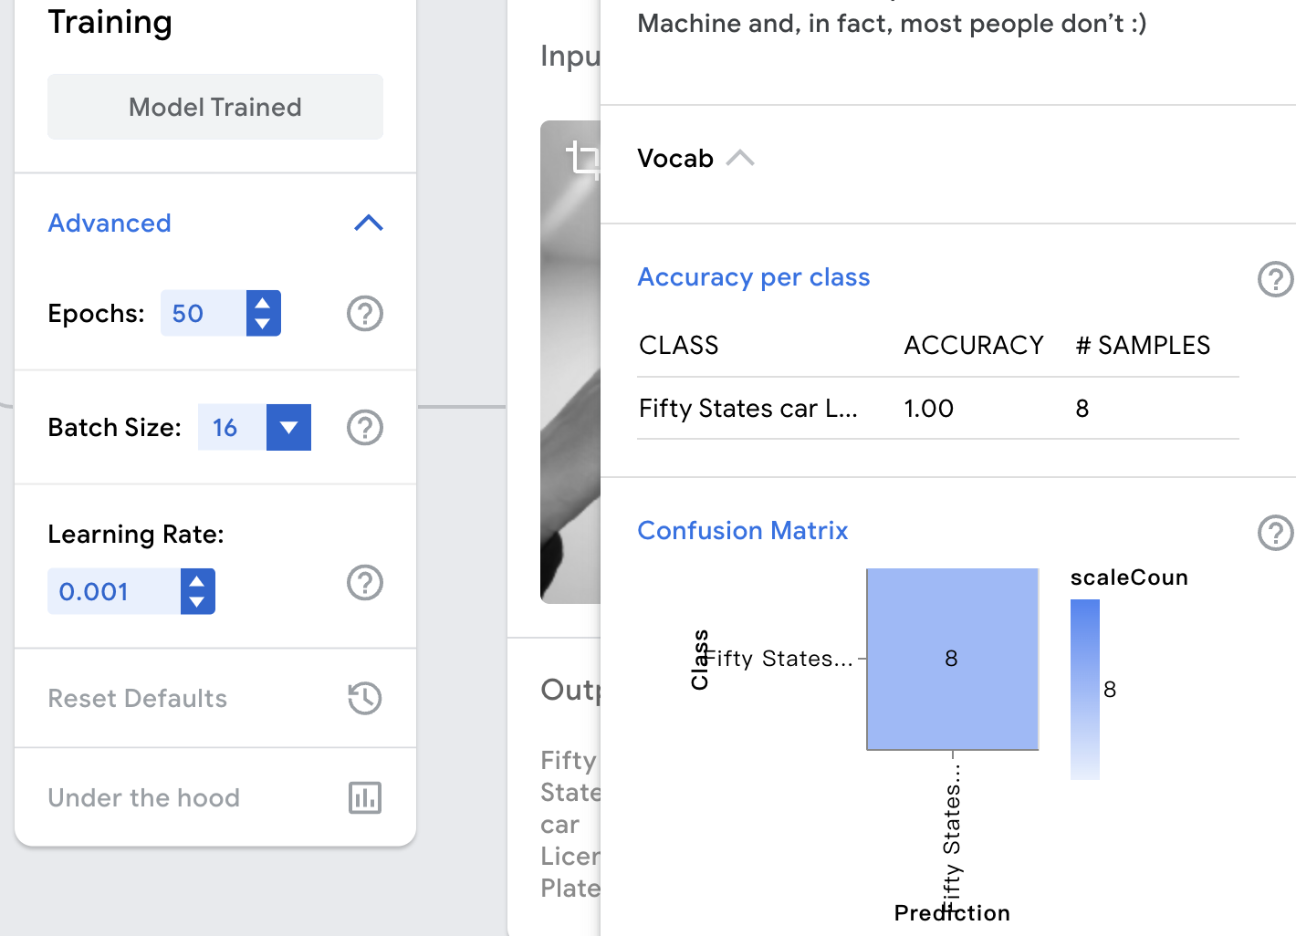
4. PDA Outcomes
Only one class
48 pictures for training, 5 picture for testing.
8 pictures have been chosen as test samples
Accuracy is 1

Slide 11
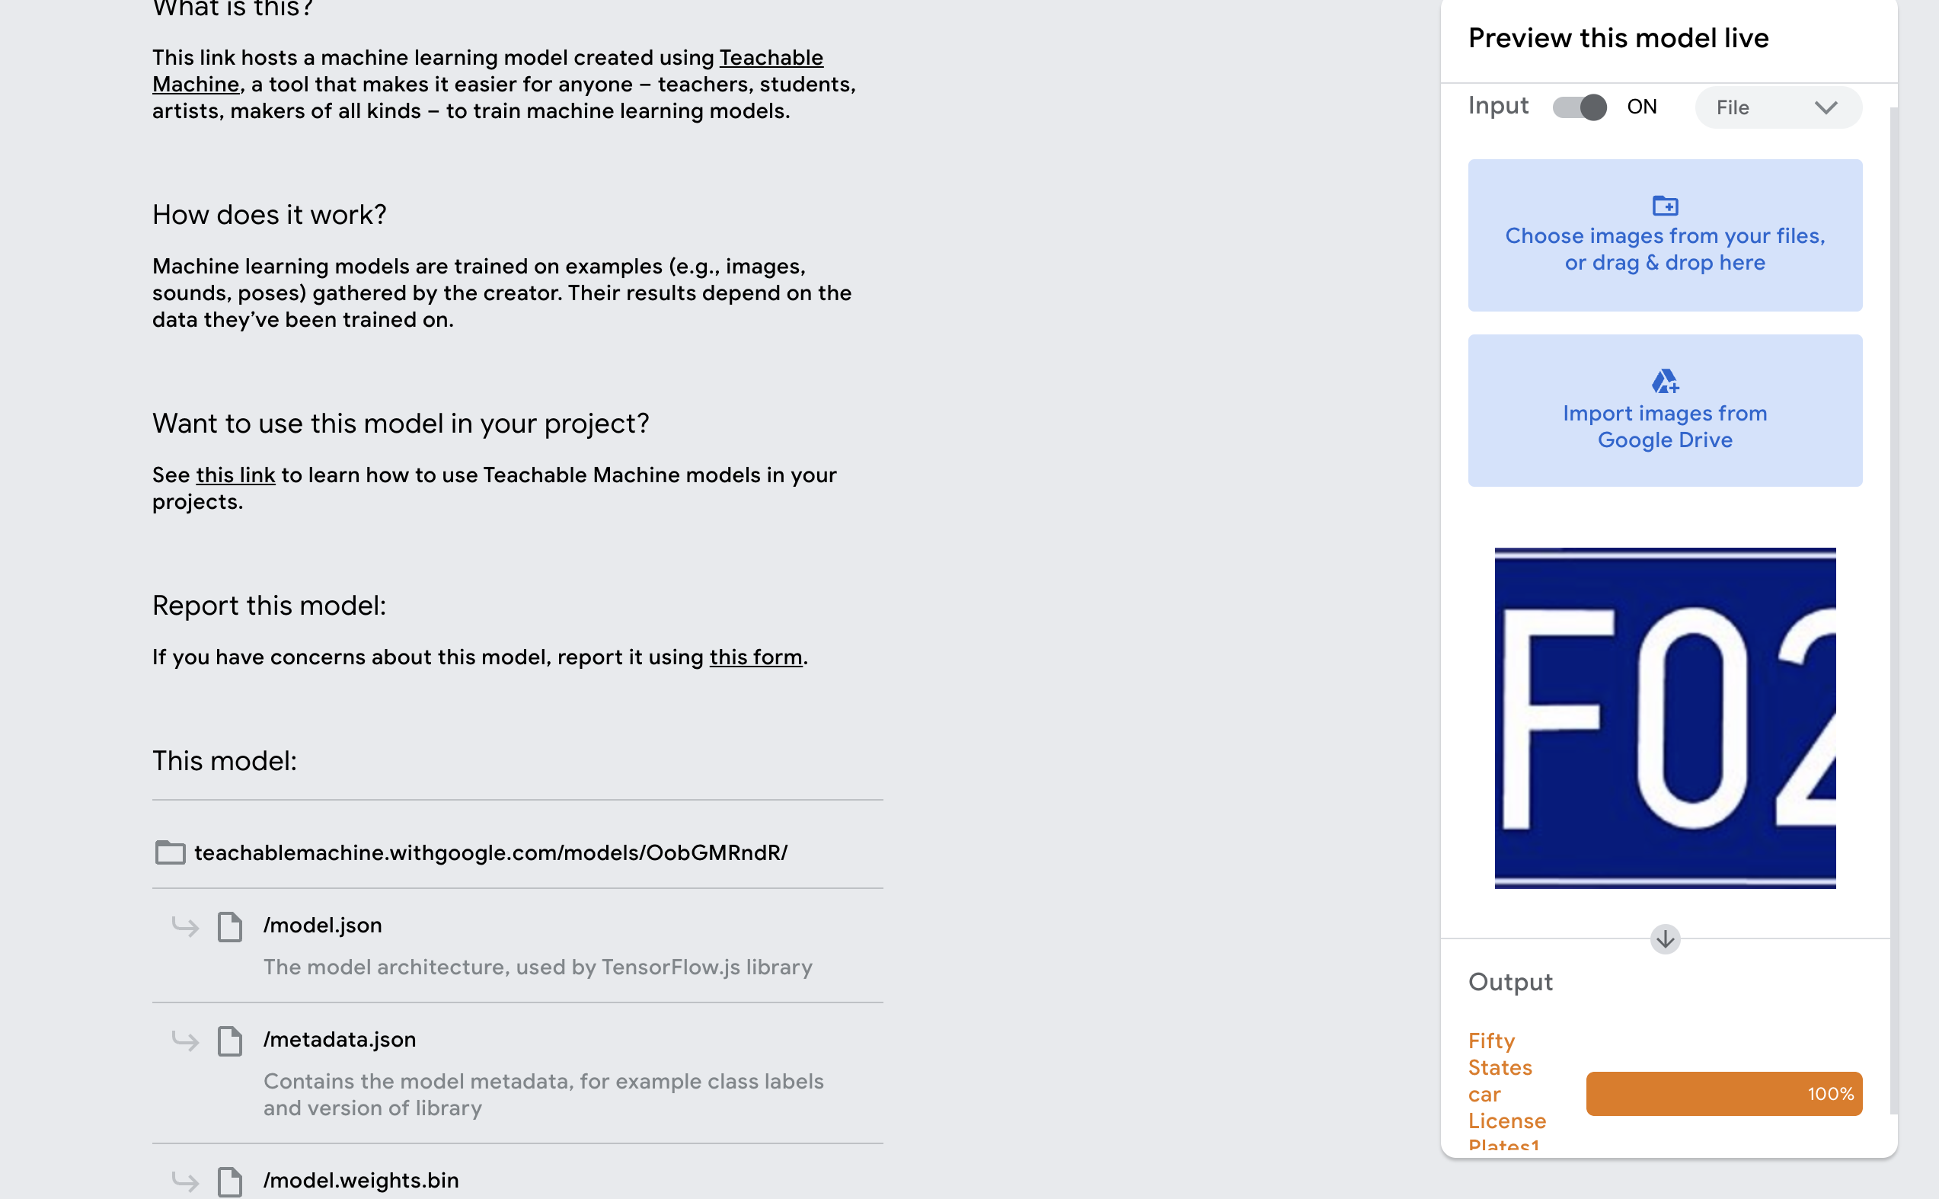
4. PDA (Predictive Data Analysis) Outcomes
Uploaded a car plate, the output is 100%

Slide 12
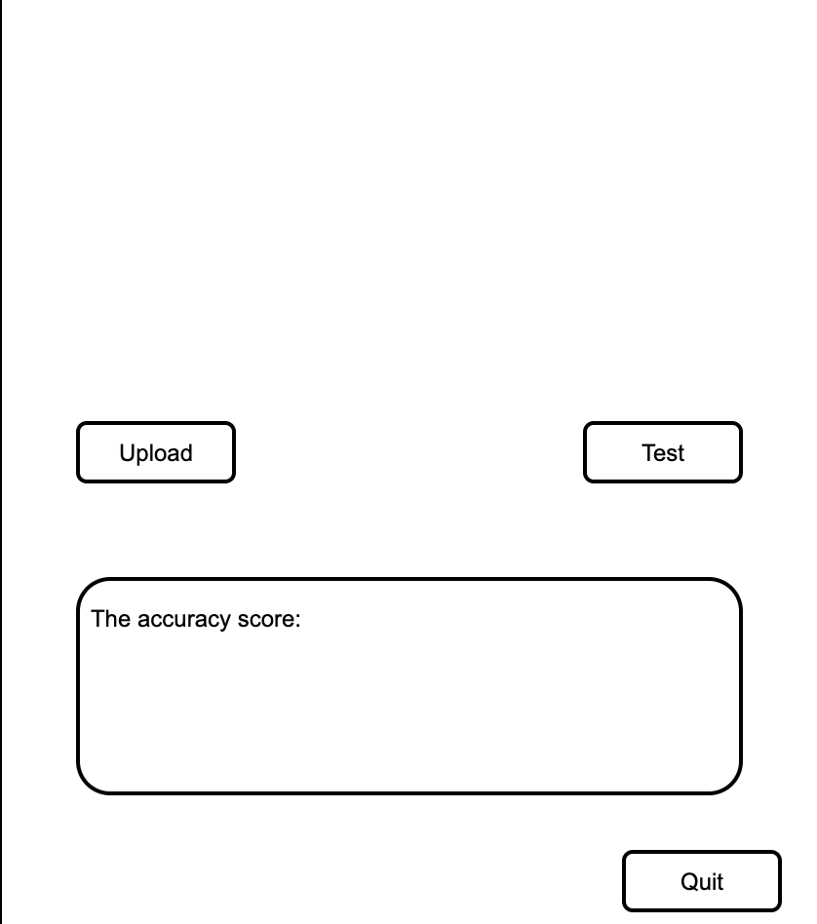
5. Implementation and Deployment (TkInter/Flask/Streamlit) Plan and Status Update
Deploying buttons and result boxes using Tkinter

Slide 13
Thank you!

